Slide 1
Hive (Apache Hive)

Slide 2
What is HIVE?
Apache Hive is a data warehouse and an ETL tool which provides an SQL-like interface between the user and the Hadoop distributed file system (HDFS) which integrates Hadoop.
It is built on top of Hadoop. It is a software project that provides data query and analysis. It facilitates reading, writing and handling wide datasets that stored in distributed storage and queried by Structure Query Language (SQL) syntax.
It is not built for Online Transactional Processing (OLTP) workloads. Hive is primarily designed for Online Analytical Processing (OLAP), which involves querying and analyzing large volumes of data efficiently rather than handling real-time transactional data.

Slide 3
What is HIVE?
Hive uses a language called HiveQL, which is similar to SQL, to allow users to express data queries, transformations, and analyses in a familiar syntax.
HiveQL statements are compiled into MapReduce jobs, which are then executed on the Hadoop cluster to process the data.

Slide 4
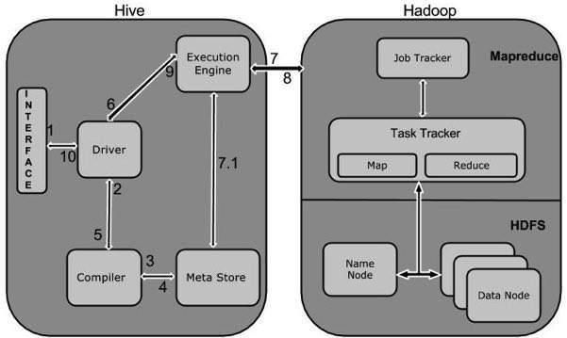
Working of Hive

Slide 5
Working of Hive
Step No. | Operation
1 | Execute QueryThe Hive interface such as Command Line or Web UI sends query to Driver (any database driver such as JDBC, ODBC, etc.) to execute.
2 | Get PlanThe driver takes the help of query compiler that parses the query to check the syntax and query plan or the requirement of query.
3 | Get MetadataThe compiler sends metadata request to Metastore (any database).
4 | Send MetadataMetastore sends metadata as a response to the compiler.
5 | Send PlanThe compiler checks the requirement and resends the plan to the driver. Up to here, the parsing and compiling of a query is complete.

Slide 6
Working of Hive
Step No. | Operation
6 | Execute PlanThe driver sends the execute plan to the execution engine.
7 | Execute JobInternally, the process of execution job is a MapReduce job. The execution engine sends the job to JobTracker, which is in Name node and it assigns this job to TaskTracker, which is in Data node. Here, the query executes MapReduce job.
7.1 | Metadata OpsMeanwhile in execution, the execution engine can execute metadata operations with Metastore.
8 | Fetch ResultThe execution engine receives the results from Data nodes.
9 | Send ResultsThe execution engine sends those resultant values to the driver.

